Slide 1


How to Build a Team
To deliver a highly distributed port scanning collector solution
Interview Presentation – SecurityScorecard Yaser Shadmehr Jan 14, 2021

Slide 2




Building Team
Architecture Blueprint
Success Criteria
Agenda

Slide 3

Building Team
Architecture Blueprint
Success Criteria
Agenda

Slide 4

Building Team
Architecture Blueprint
Success Criteria
Agenda

Slide 5

Building Team
Architecture Blueprint
Success Criteria
Agenda

Slide 6

Building Team
Architecture Blueprint
Success Criteria
Agenda

Slide 7

Large image
1
No solid recipe for building a team
Close attention to team working.
Learn and prepare action plan in agile way.
Improve the level of trust and cooperation gradually.
2
Born in the new professional family
Observation and Self-Awareness.
Deep dive in Company and customer Values.
One-to-one session and Q&A
Learn culture, standard and processes.
3
Team Collaboration
Clear objectives & roles.
Open communication & team achievement.
Improve cooperation among team members.
Creating transparency and trust.
4
Establish a Connection with Team Member
Learn specific skills, interests and drawbacks.
Brainstorming session to hear individual ideas.
Provide opportunities for personal development.
Coaching tool
5
Monitor And Review
Result Oriented, What’s working well?
What has the team achieved so far?
What did they change, learn?
Help team to review themselves individually.

Slide 8
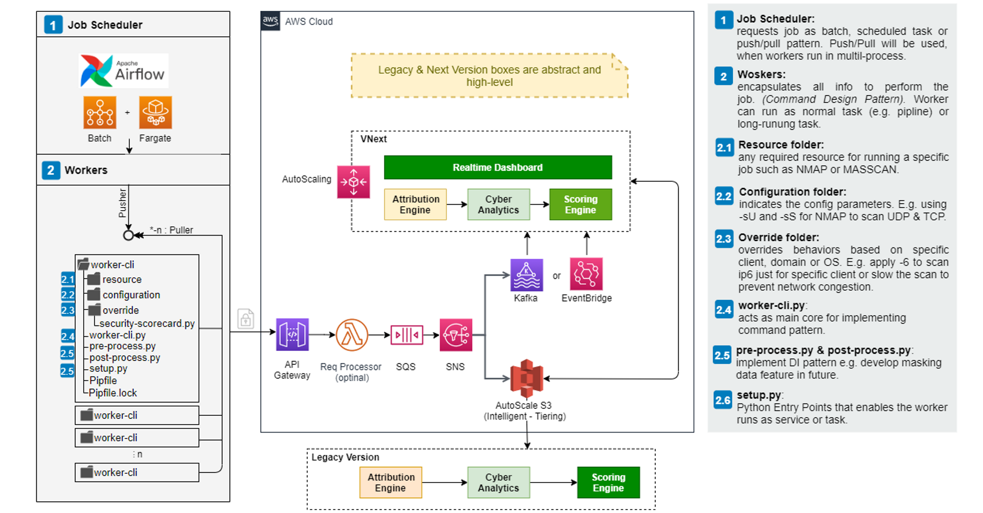
Large image
Architecture Blueprint Auto Scale Port Scanning Collector

Slide 9
Large image
Architecture Blueprint Auto Scale Port Scanning Collector

Slide 10


Balanced scorecard slide 4
Success Criteria
measure what’s important to
business & stakeholders in a milestone
Process:
Specify Success Criteria
Budget & Business Goal
How to do Baselining performance
Monitoring & Tracking:
Delivery/Change Management
Status Project Report
Coding Quality & Standard
PM & Software KPI
Success is Share Responsibility including Leadership, Business, PM, SME, Architect, DEV, QA
Technology:
Code Quality Assurance
Architectural and Design direction
Control Technical Debt
Application lifecycle management
People Management:
Promote Collaboration and Engagement
Managing and Hiring
Couch and Mentoring
10

Slide 11



Thank You
Work hard Have fun And make history together!
Yaser Shadmehr
y.Shadmehr@gmail.com
The content of this presentation is inspired by my interview with SecurityScorecard and it may contain false assumption or confidential information.

